Slide 1

R FOR ABSOLUTE BEGINNERS
NUSHRAT KHAN
ALISON BLAINE
JENNIFER GARRETT
https://www.lib.ncsu.edu/workshops

Slide 2


LIFE IN A WORLD OF DATA
Imagine yourself stranded in a world of data and you’re looking for a better way to process them…

Slide 3

R IS WHAT YOU NEED
R programming language can be your friendly robot that can assist you to do everything with your data!

Slide 4
WHAT IS R?
“Free software environment for statistical computing and graphics.” – R-Project [1]
The R Project for Statistical Computing. (n. d.). Retrived from https://www.r-project.org/
Open source & Extensible
Intermediate tools for data analysis
R
Graphical facilities for data analysis and display
Well developed, simple and effective programming language

Slide 5
OTHER STATISTICAL PACKAGES
Some well-known statistical packages include –
MATLAB – Programming language with statistical features
Mathematica – A software package with statistical feature
SAS – Comprehensive statistical package
SPSS (Statistical Package for Social Sciences) – Comprehensive statistical package

Slide 6

WHY USE R?
All the other software mentioned are proprietary
Not only a package but also a programming language
Powerful data handling and storage facility while simple, effective and flexible
Can write your own package if necessary and make it available for others use

Slide 7
APPLICATIONS OF R
Application Methods
Finance
Data Import
Sports
Bio Science
Data Cleaning
Application Domains
Investigation
Data Analysis
Marketing
Retails
Visualization

Slide 8
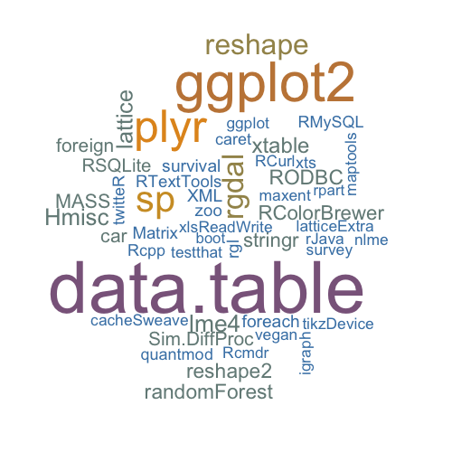
PACKAGES IN R
Packages are libraries of functions that are built to perform some specific tasks, i.e. create plots.
R is supplied with about eight packages but more can be easily added and extended
To install a new package type in console –
install.packages(“package_name”)
library(package_name)
Image from http://bxhorn.com/category/r-packages/

Slide 9
PACKAGES USED
For the hands-on exercises we will use the packages below. These are some of the widely used libraries in R.
Hmisc¹ – Provides numerous functions for data analysis, high level graphics, utility operations etc. We will explore the “describe” function for our exercise.
Dplyr² – Contains many functions to make data manipulation easier, i.e. filter(), arrange(), distinct().
ggplot2³ – This package allows us to create graphs that are represented by color, symbol, size and transparency. There is a helper function qplot() that simplifies complex codes for some standard graphs
Overview of Hmisc Library. (n.d.). Retrieved from http://math.furman.edu/~dcs/courses/math47/R/library/Hmisc/html/Overview.html
Introduction to dplyr. (2016, June 23). Retrieved from https://cran.rstudio.com/web/packages/dplyr/vignettes/introduction.html
Quick-R: ggplot2 Graphs. (n.d.). Retrived from http://www.statmethods.net/advgraphs/ggplot2.html

Slide 10
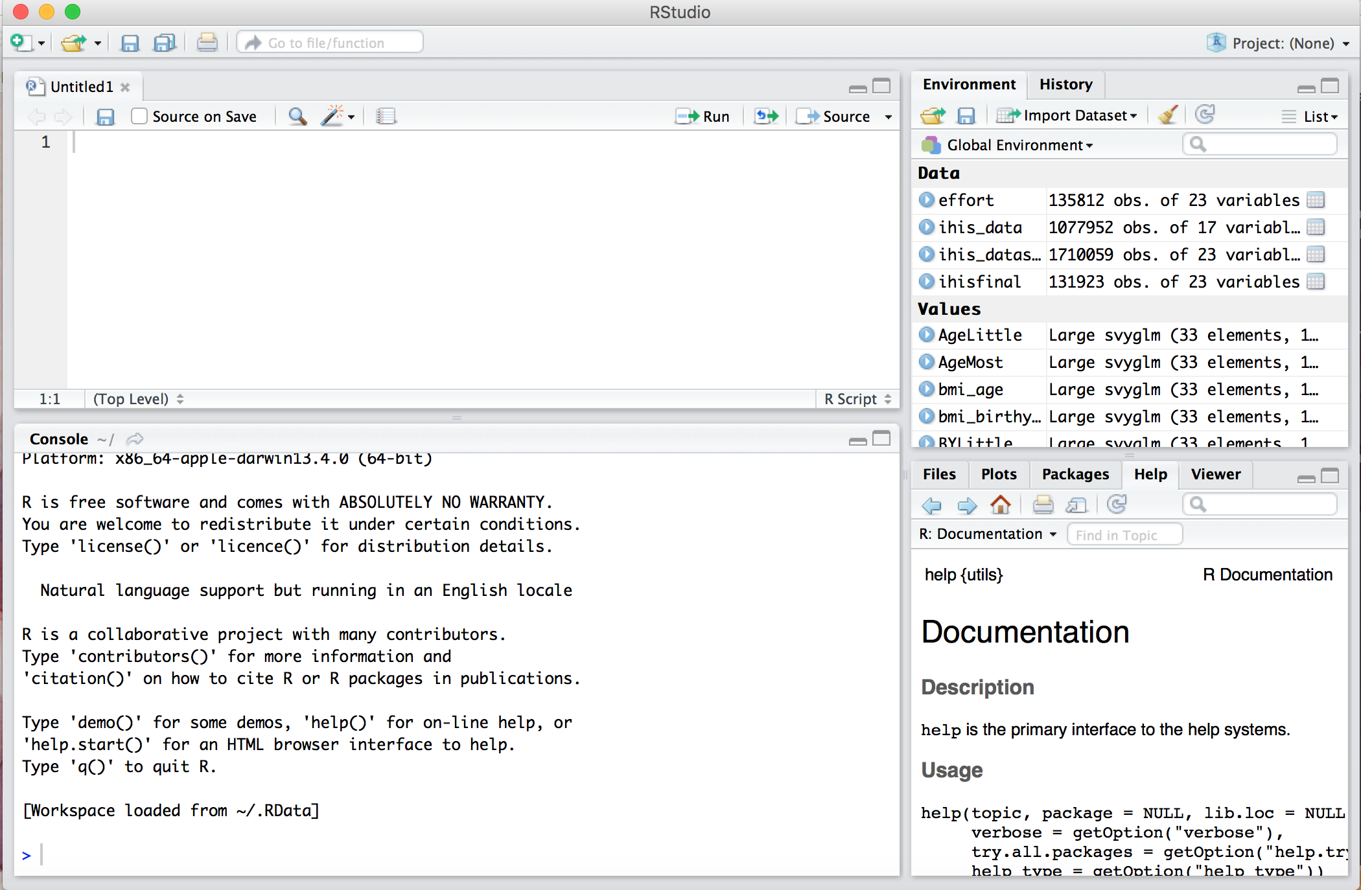
ABOUT R-STUDIO
A powerful user interface for R that is free, open source and works in all platforms.
Script
Environment/ History
Console
Browser/ Viewer

Slide 11
WORKING DIRECTORY
Working directory – Directory of a hierarchical file system
In R Studio we can set our working directory to indicate where we want to get our data from and save our data to.
Method 1 (From the main menu) – Session > Set Working Directory > Choose Directory
Method 2 (On console) – setwd(directory_path)
Method 3 (Files browser) – Select directory > Select ‘More’ from menu > Select ‘Set As Working Directory’
More on - R Studio Support Page

Slide 12
VARIABLES AND FUNCTIONS IN R
What is a variable?
In programming a variable is a value that can change based on the conditions. It can be useful in complex calculation by not having to repeat writing long code.
Example : x <- c(1,2,5,7) – here x is a variable that is holding the value of vector c
What is a function?
A function can be defined as a sub program that can be used repeatedly to perform the same task where needed. In R users can write their own functions where necessary.
Example: f1 <- function(x,y) {x+y}. So, f1(1,3) will return 4.

Slide 13
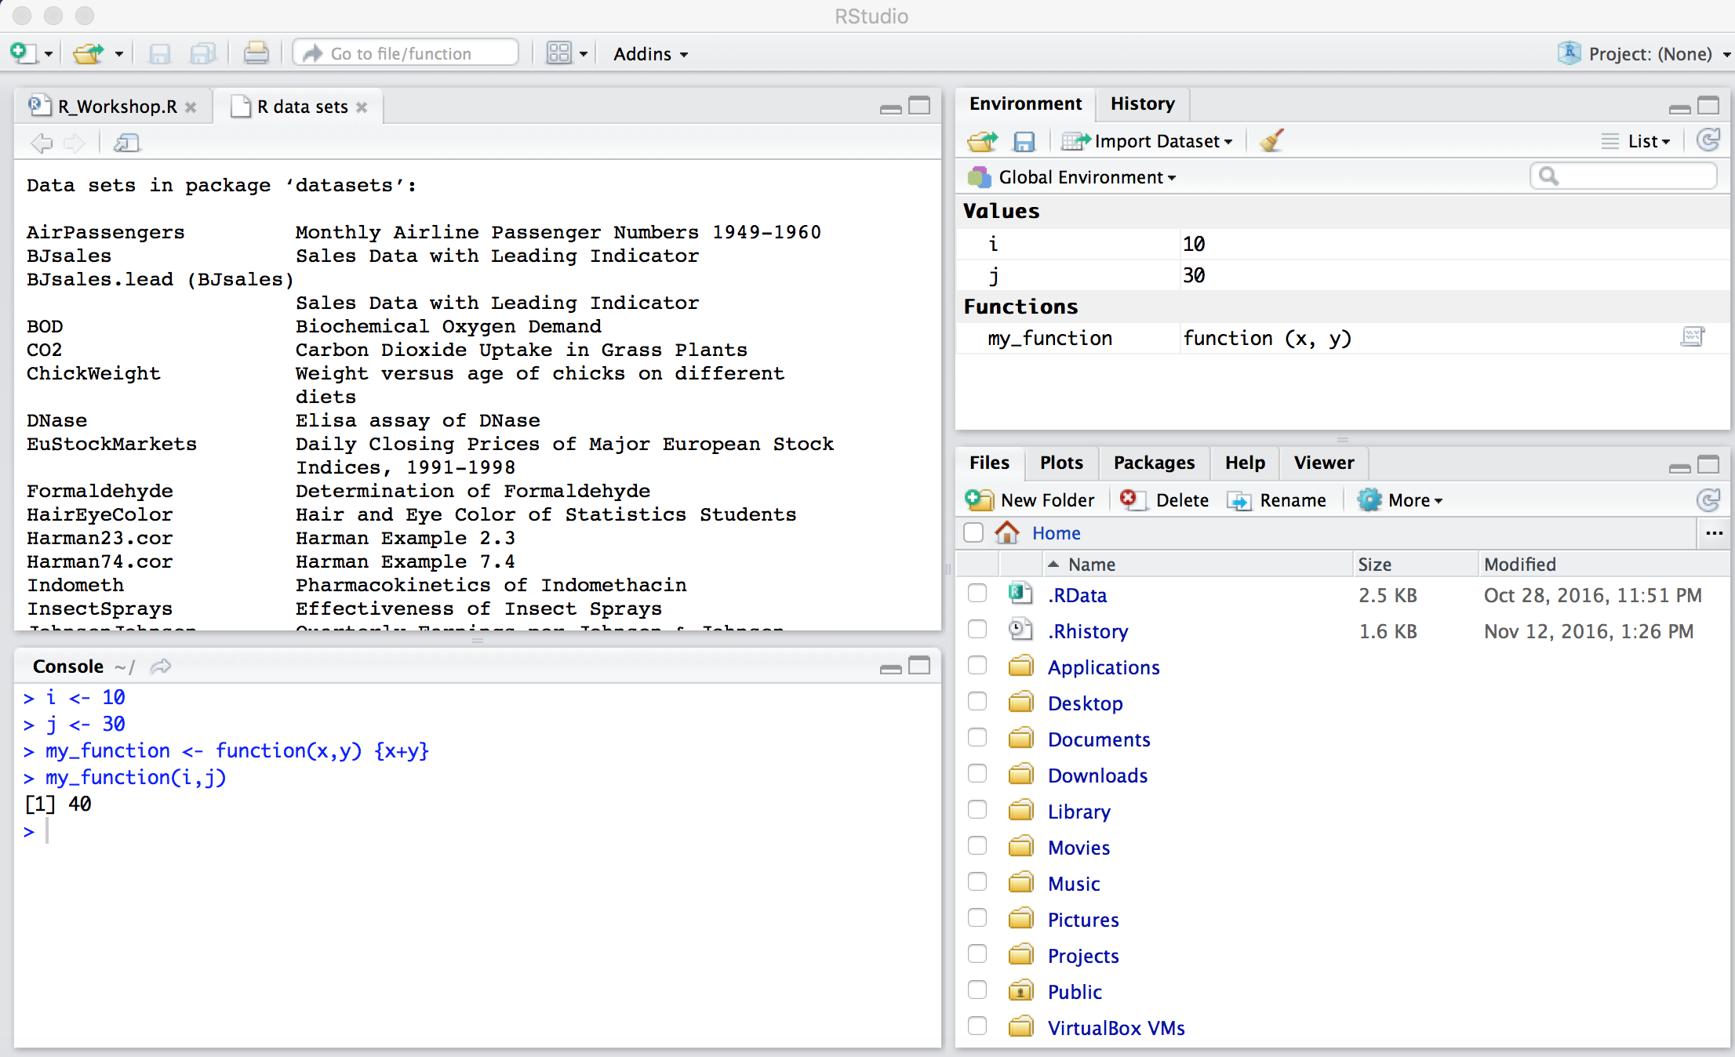
VARIABLES & FUNCTIONS (CONT’D)

Slide 14
WORKING WITH DATA
Create your own data frame by joining multiple vectors (sequence of data elements of the same basic type).
Load your own datasets
Work with the sample datasets that comes with R to learn and test
To view the list of available datasets run this command in console – data()
View and download any available dataset from this page - https://stat.ethz.ch/R-manual/R-devel/library/datasets/html/00Index.html
For this workshop we will use airquality and mtcars datasets provided by R

Slide 15
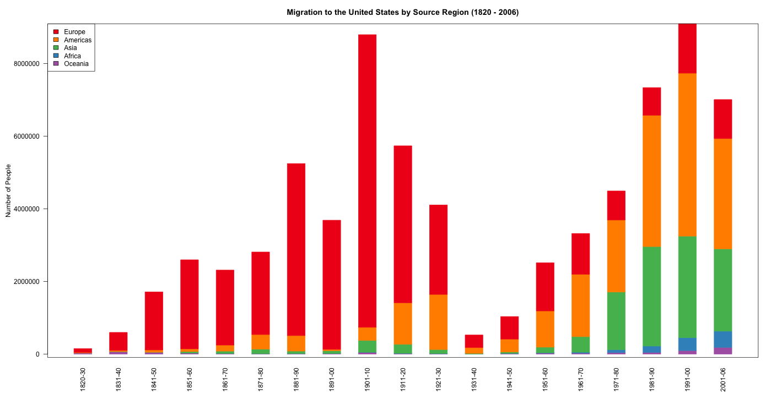
VISUALIZATION WITH R
Visualization is made pretty easy with R, where most basic ones can be done with the plot command.
Types of visualization supported –
Basic Visualization
Histogram
Bar/ Line Chart
Box Plot
Scatter Plot
Advanced Visualization
Heat Map
Mosaic Map
Map Visualization
3D Graphs
Correlogram
To learn more about visualization with R refer to:
Chang, W. (2012). R graphics cookbook. " O'Reilly Media, Inc.” *
* E-book is accessible from NCSU library, but only one person at a time.

Slide 16
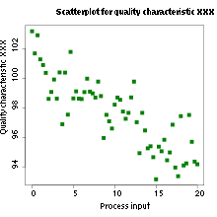
SCATTER PLOT
A graph in which the values of two variables are plotted along two axes, the pattern of the resulting points revealing any correlation present.
The data is displayed as a collection of points, each having the value of one variable determining the position on the horizontal axis and the value of the other variable determining the position on the vertical axis. (https://en.wikipedia.org/wiki/Scatter_plot)

Slide 17
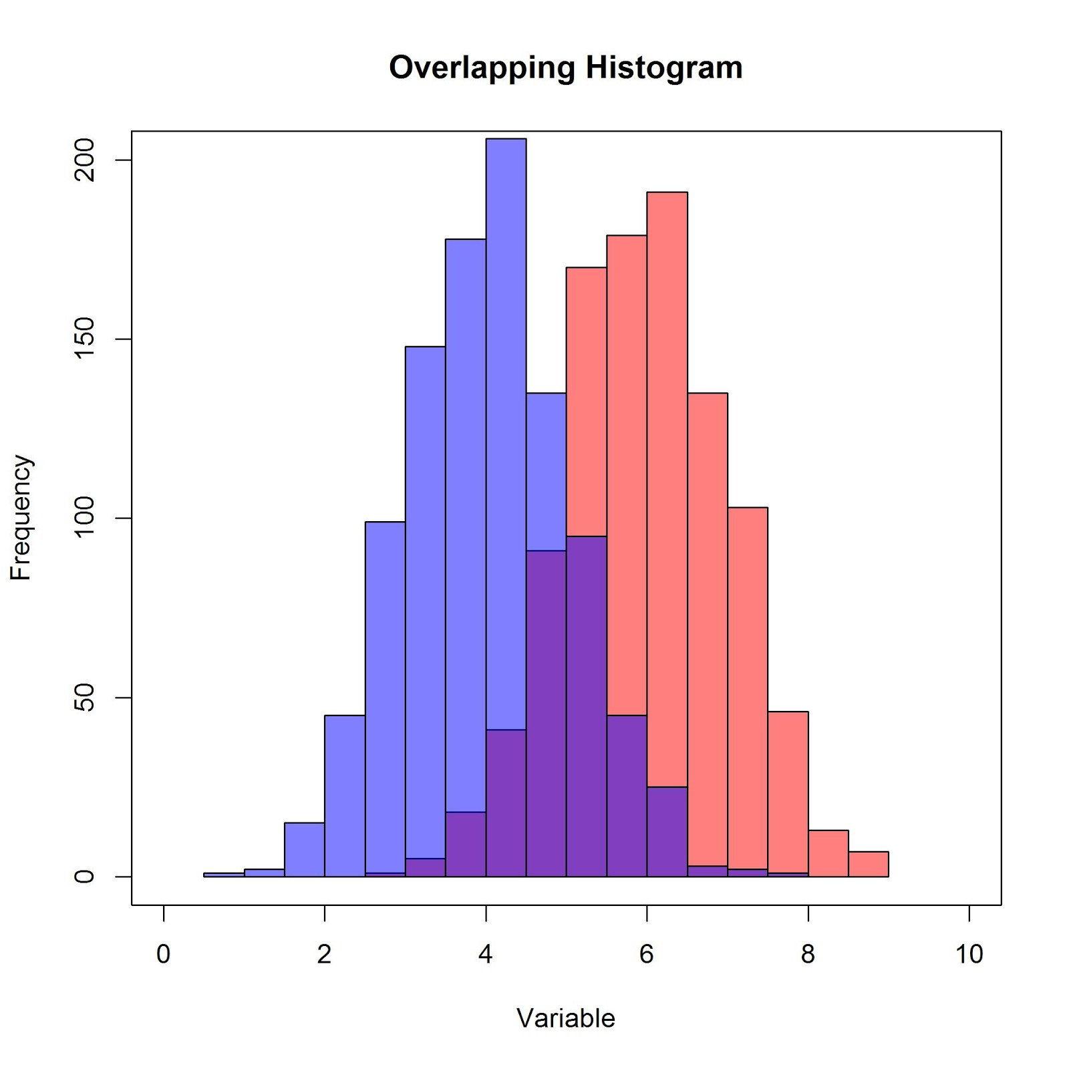
HISTOGRAM
A histogram is a graphical representation of the distribution of numerical data. It is an estimate of the probability distribution of a continuous variable (quantitative variable).
(https://en.wikipedia.org/wiki/Histogram)

Slide 18
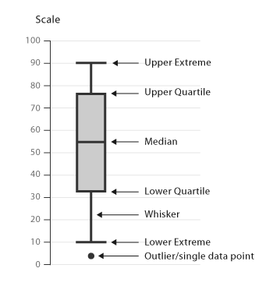
BOX PLOT
The box plot (a.k.a. box and whisker diagram) is a standardized way of displaying the distribution of data based on the five number summary: minimum, first quartile, median, third quartile, and maximum. (http://www.physics.csbsju.edu/stats/box2.html)

Slide 19
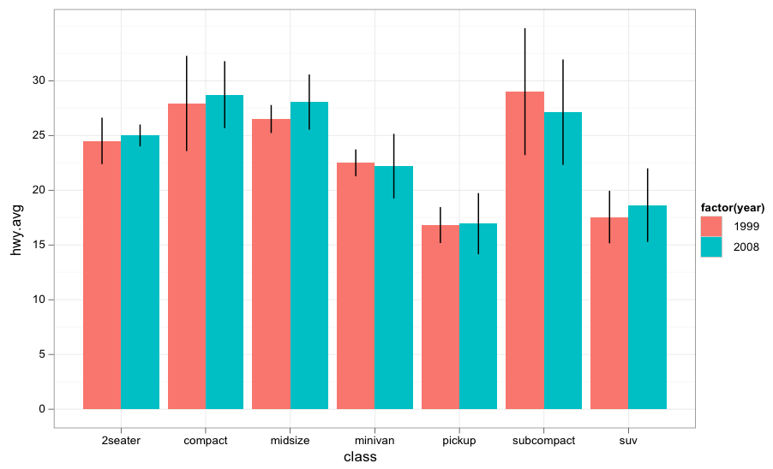
BAR PLOT
A bar chart or bar graph is a chart or graph that presents grouped data with rectangular bars with lengths proportional to the values that they represent. The bars can be plotted vertically or horizontally. A vertical bar chart is sometimes called a Line graph. (https://en.wikipedia.org/wiki/Bar_chart)

Slide 20
GET R & R-STUDIO ON YOUR MACHINE
Open the terminal in your machine and type ‘which r’. If R is already installed then it will show the path where it is located. Follow the link below to download R if it is not included.
R can be downloaded from any of the CRAN mirrors - https://cran.r-project.org/mirrors.html. It is available for all types of OS – Windows, Linux and Mac.
After downloading R, open the package and install it following the installation instructions.
R Studio can be downloaded from the website - https://www.rstudio.com/products/rstudio/download3/
Install R Studio following the instruction and R can be launched from the console within.

Slide 21
OTHER RESOURCES
Impatient R – Quick tutorial of R basics for the beginners. Link: http://www.burns-stat.com/documents/tutorials/impatient-r/
R – bloggers – A compiled resource useful articles on R from about 580 blogs. Link: https://www.r-bloggers.com/
A short list of the most useful R commands - http://www.personality-project.org/r/r.commands.html
Learn more advanced topics in depth from this book (freely available) - Wickham, H. (2014). Advanced R. CRC Press.

Slide 22
WORKSHOP MATERIALS
Go to this link:
http://go.ncsu.edu/rworkshop

